Slide 1
1.Draw the function f (x) = x + 1 from the set of real numbers and determine the function type. (Marks-2.5) Time-5 min

Slide 2
2. Translate the statement into English ∀x∀y((x > 0) ∧ (y < 0) → (xy < 0)), Where the domain for both variables consists of all real numbers. (Marks-2) Time-5 min

Slide 3
3.Build a binary tree for Bus, Truck, Car,CnG,Road,Trafic,Beggers,Shop,Signal,lamp post, Trees,Dust,Sound. (marks 7)(min5)

Slide 4

4. Draw the subtree of the game tree for tic-tac-toe beginning at the position.(marks 1)(min5)

Slide 5
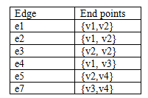
5.Draw the graph that has 4 (FOUR) vertices v1, v2, v3, and v4 and the edges as given in the table below. And prove handshaking theorem-I.(Marks-4) (Min-10)

Slide 6
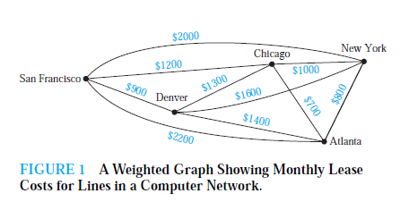
6.Find minimum spanning tree using Prim’s algorithm from this graph.Marks-3 (Min-10)

Slide 7
7.Express the statements.(Marks-4) (Min-10)
Let C(x) be the statement “x has a cat,” let D(x) be the statement “x has a dog. Express each of these statements in terms of C(x), D(x), quantifiers, and logical connectives. Let the domain consist of all students in your class.
i) A student in your class has a cat and a dog.
ii) All students in your class have a cat or a dog.
iii) Some student in your class has a cat but not a dog.
iv) No student in your class has a cat and a dog.

Slide 8
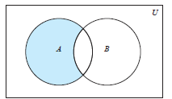
What does this figure denotes?

Slide 9
Let A = {a, b, c, d, e} and B = {a, b, c, d, e, f, g, h}.
Find
a) A ∪ B. b) A ∩ B.
c) A − B. d) B − A.
Also find,What is the power set of set A?

